Slide 1

Combinational Logic

Slide 2

Outline
4.1 Introduction
4.2 Combinational Circuits
4.3 Analysis Procedure
4.4 Design Procedure
4.5 Binary Adder- Subtractor
4.6 Decimal Adder
4.7 Binary Multiplier
4.9 Decoders
4.10 Encoder
4.11 Multiplexers

Slide 3

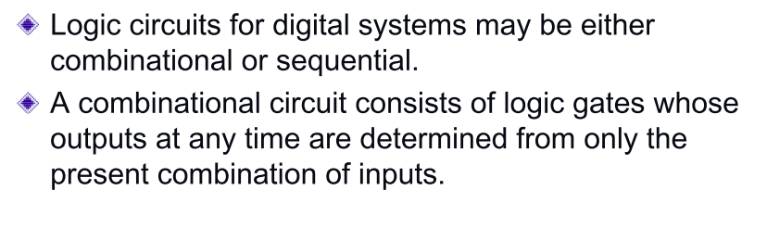
Introduction

Slide 4
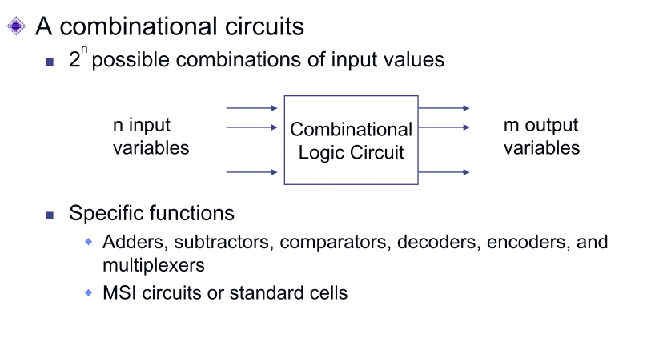
Combinational Circuits

Slide 5
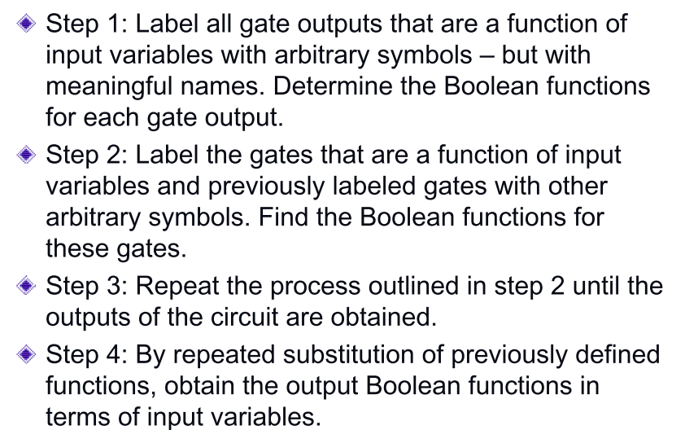
Analysis Procedure

Slide 6
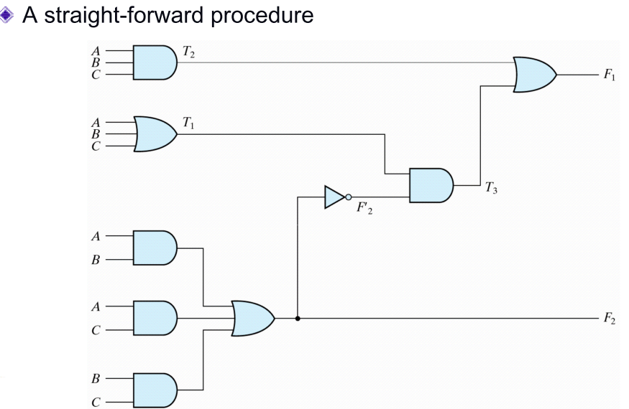
Analysis Procedure Example

Slide 7
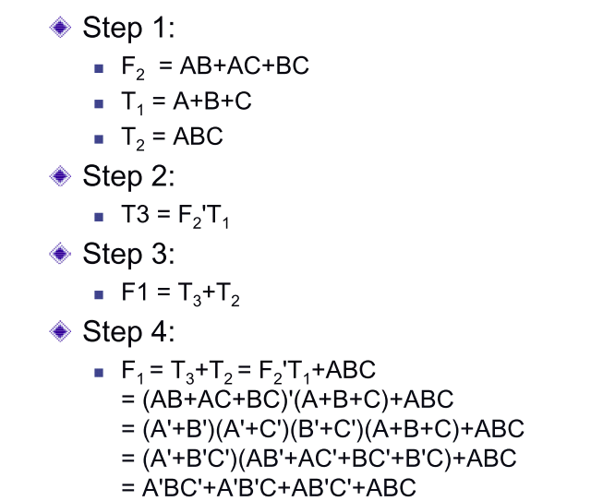
Analysis Procedure Example

Slide 8
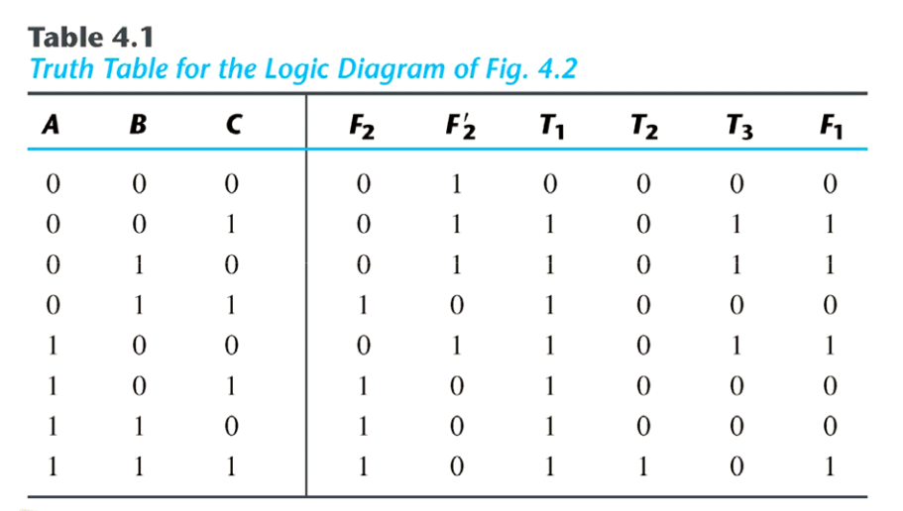
Truth Table

Slide 9
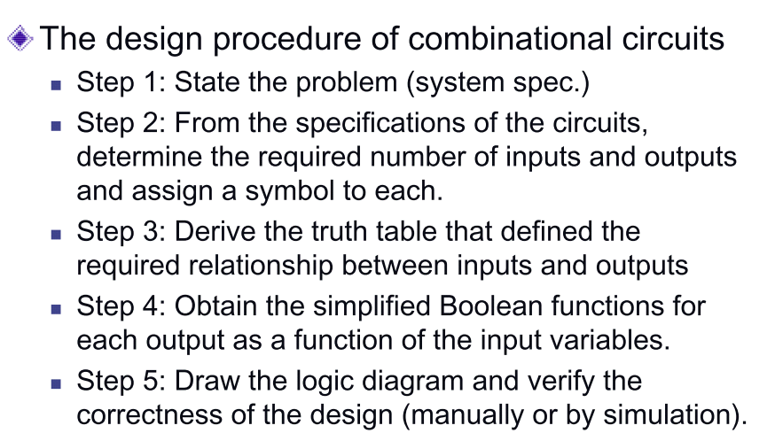
Design Procedure

Slide 10
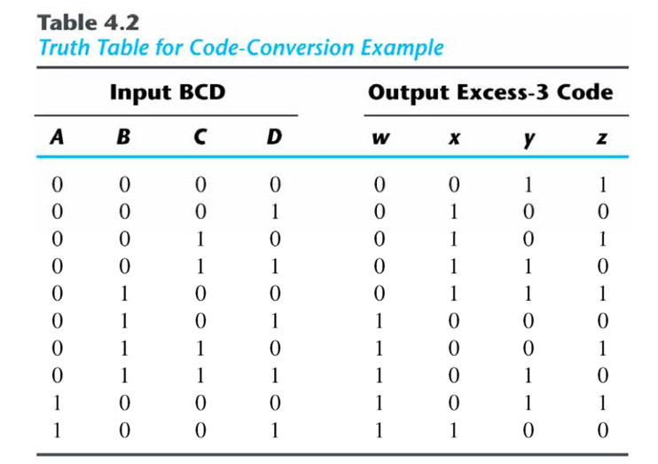
BCD To Excess-3 Code Conversion

Slide 11
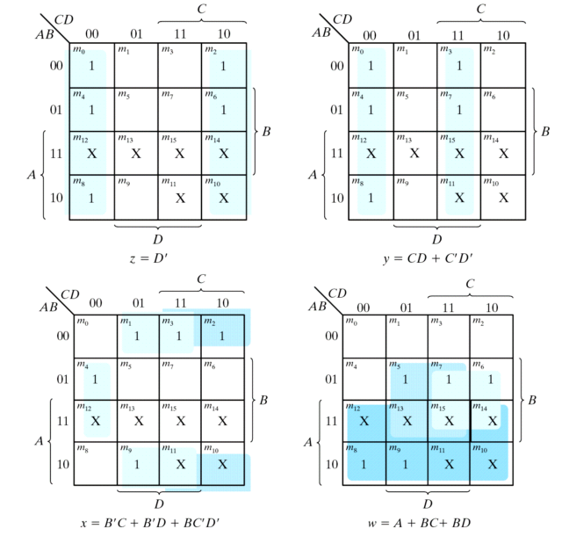
BCD To Excess-3 Code Conversion

Slide 12
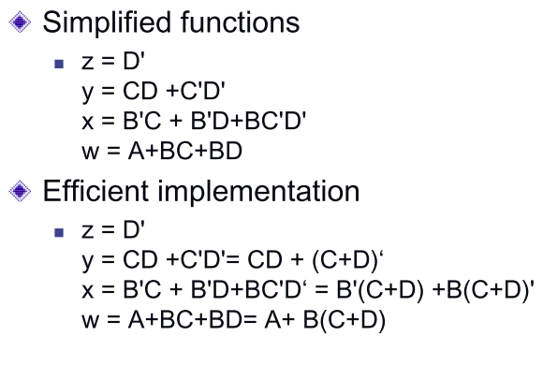
BCD To Excess-3 Code Conversion

Slide 13
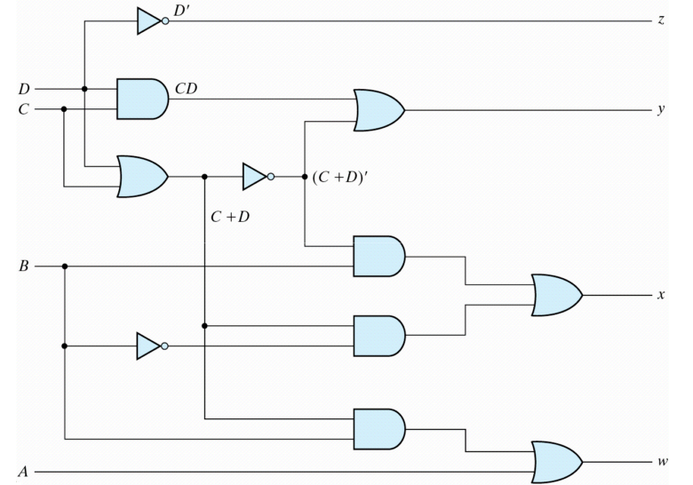
Logic diagram for BCD-to-excess-3 Converter

Slide 14
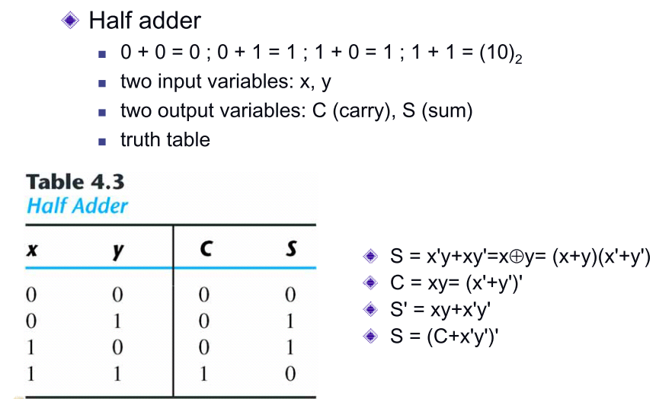
1-Bit Half Adder

Slide 15
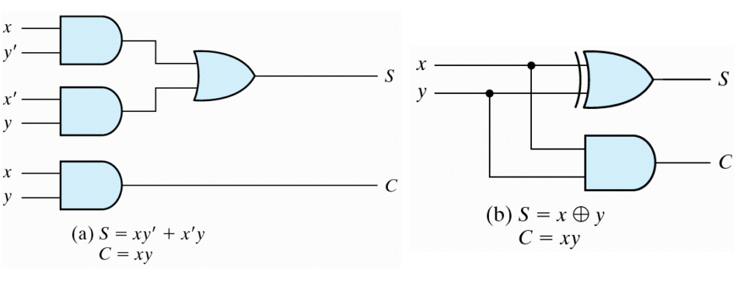
Implementation of Half Adder

Slide 16
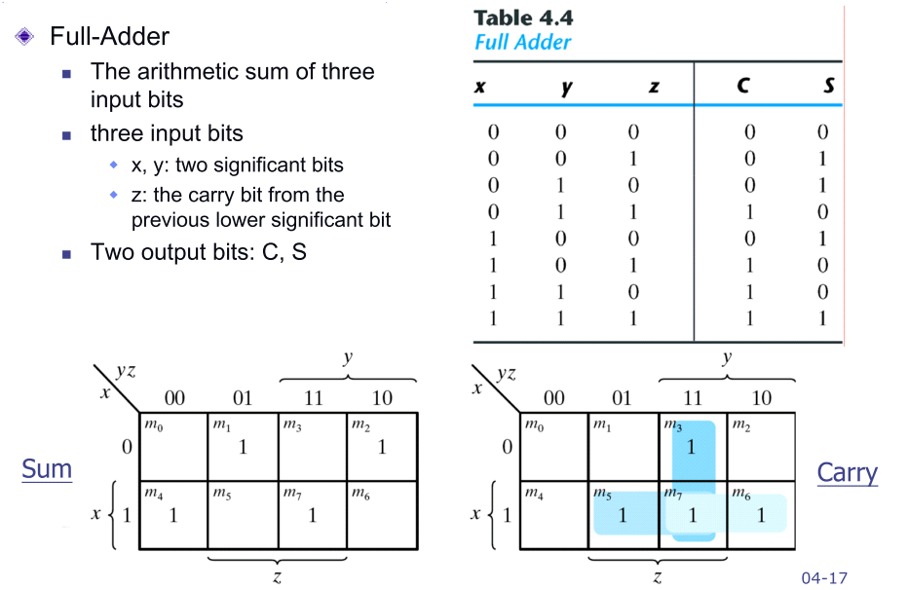
1- Bit Full Adder

Slide 17
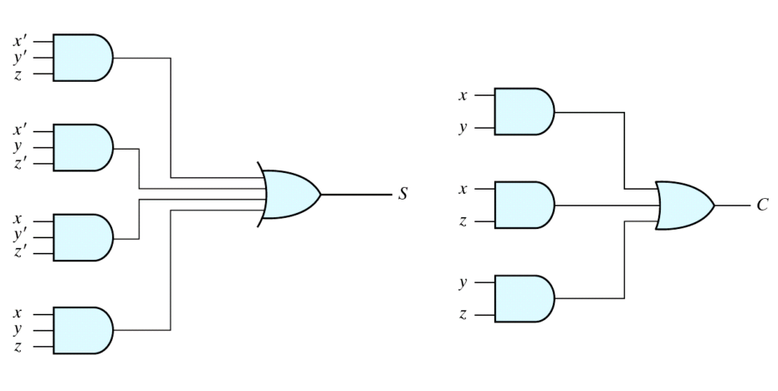
Implementation of full adder in sum-of-products form

Slide 18
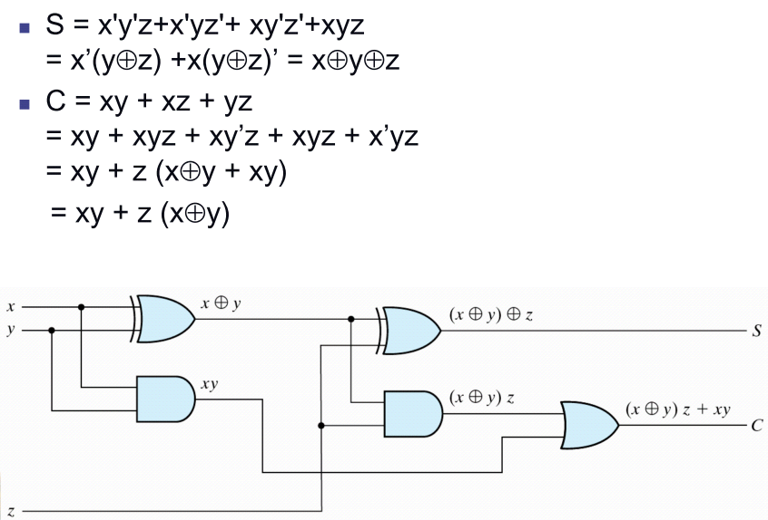
Implementation of Full Adder With Two Half Adders and an OR gate

Slide 19
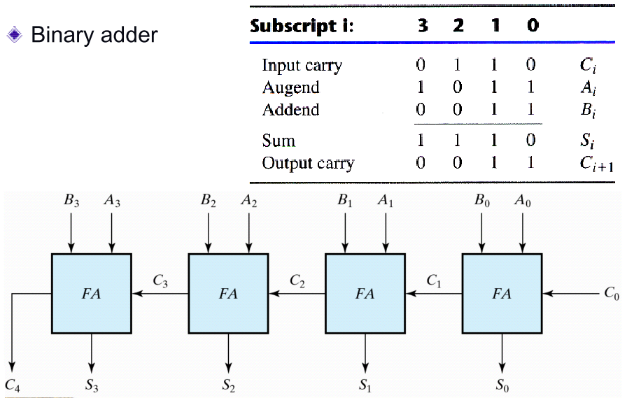
4- Bit Full Adder

Slide 20
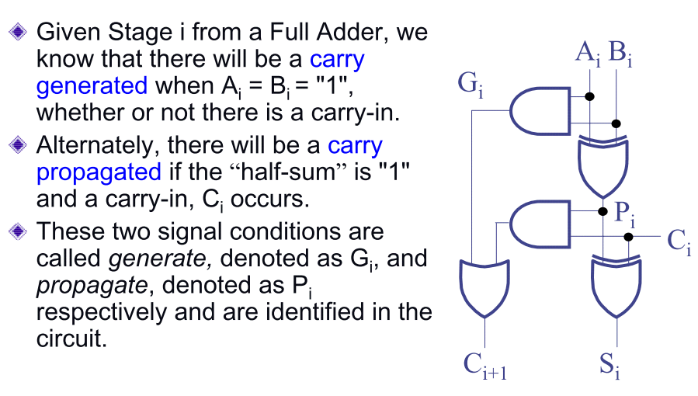
Carry Lookahead Adder (1/7)

Slide 21
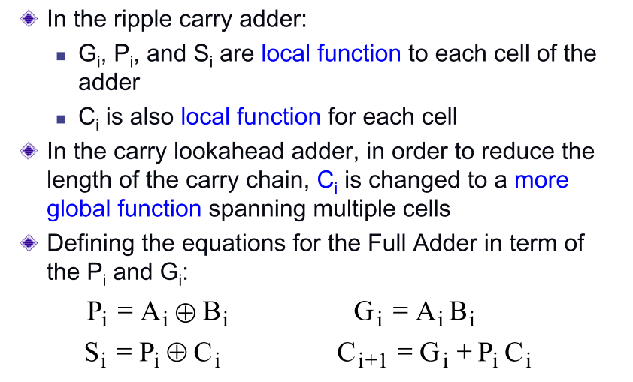
Carry Lookahead Adder (2/7)

Slide 22
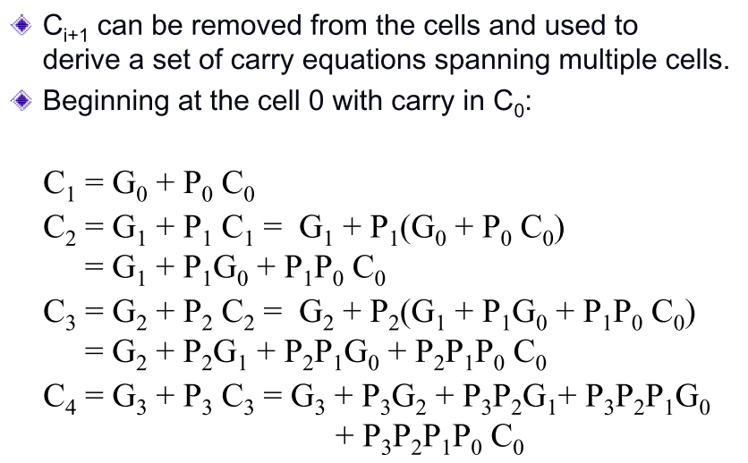
Carry Lookahead Adder (3/7)

Slide 23
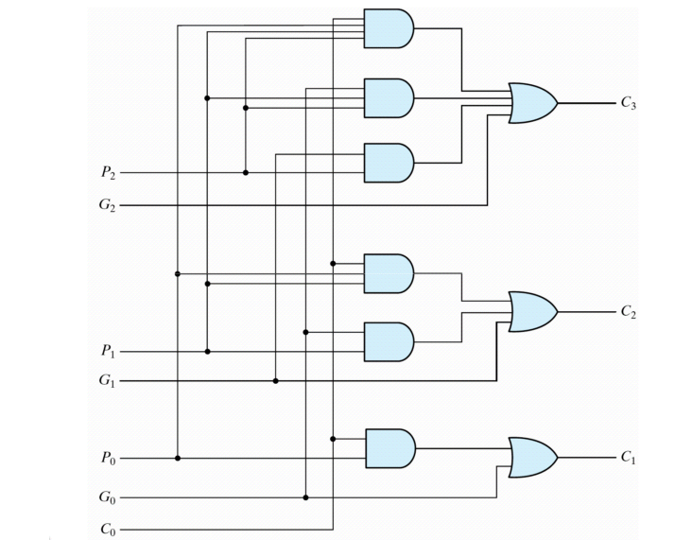
Carry Lookahead Adder (4/7)

Slide 24
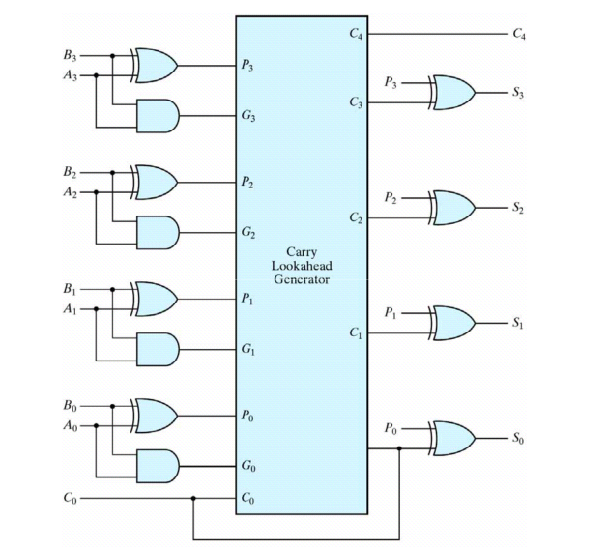
Carry Lookahead Adder (5/7)

Slide 25
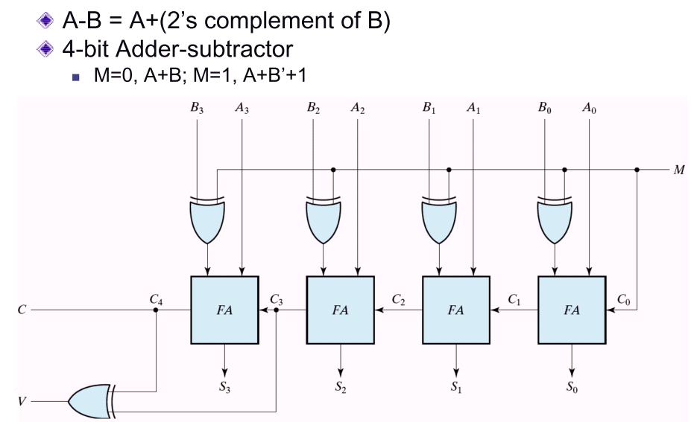
4-Bit Adder/Subtractor

Slide 26
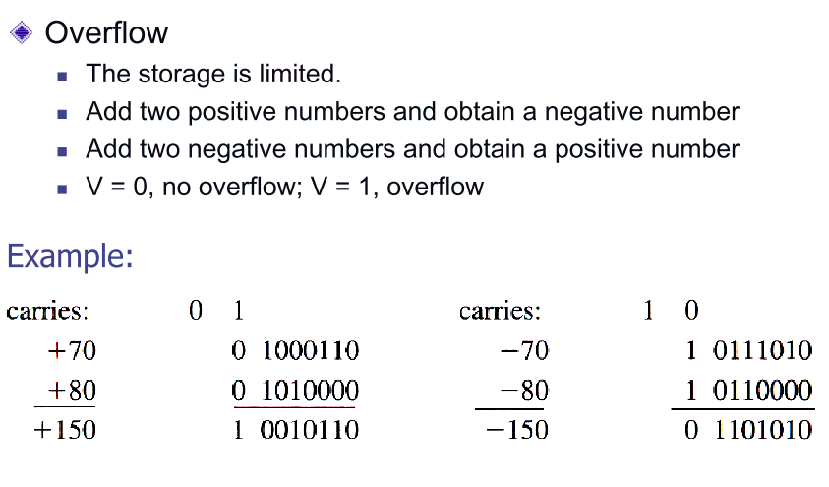
Overflow Discussion

Slide 27
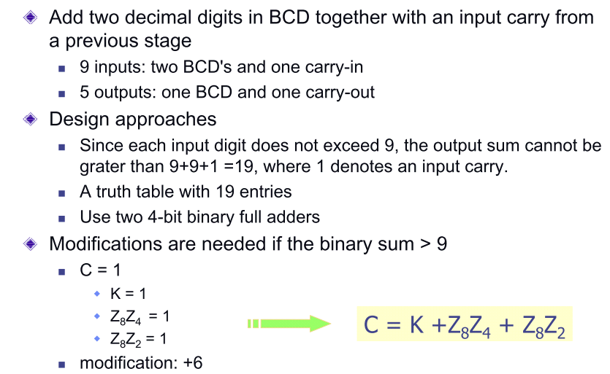
BCD Adder

Slide 28
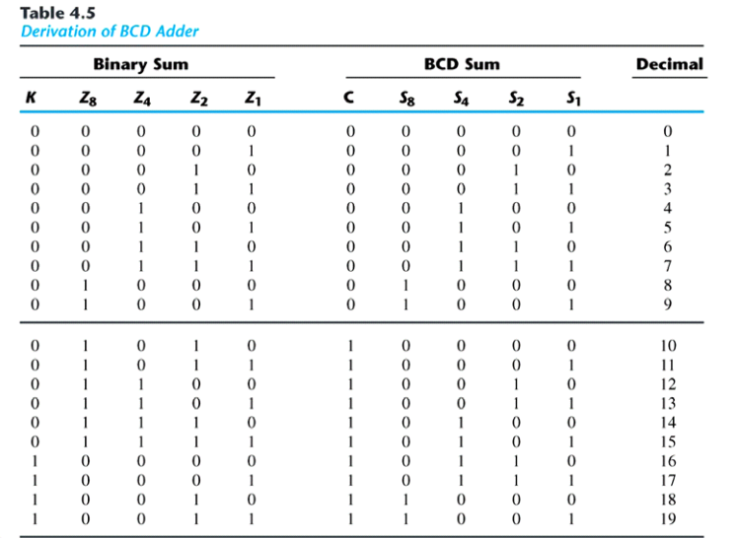
Truth Table of BCD Adder

Slide 29
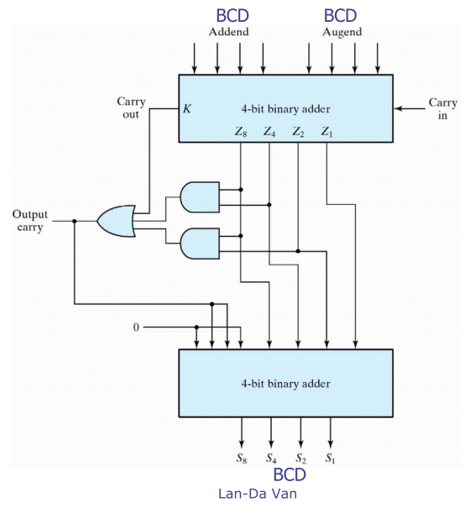
Logic Diagram of BCD Adder

Slide 30
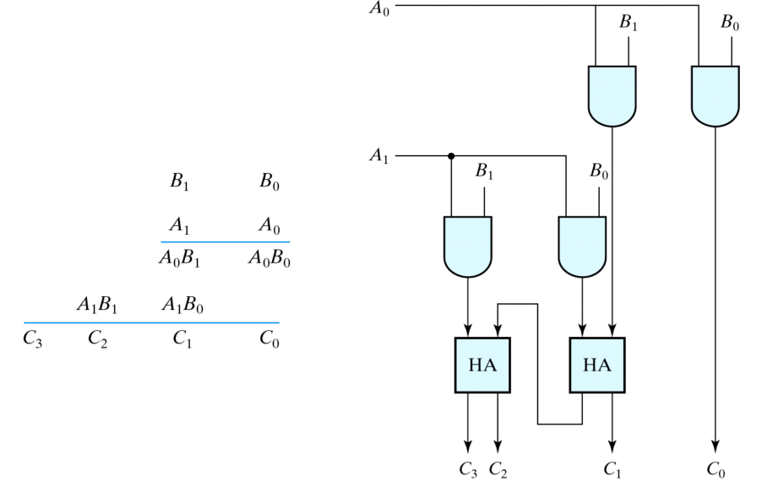
Binary Multiplier

Slide 31
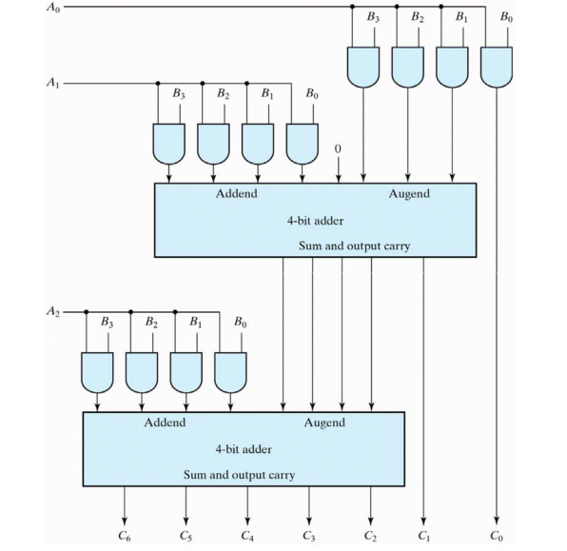
Bit by 3-Bit Binary Multiplier

Slide 32
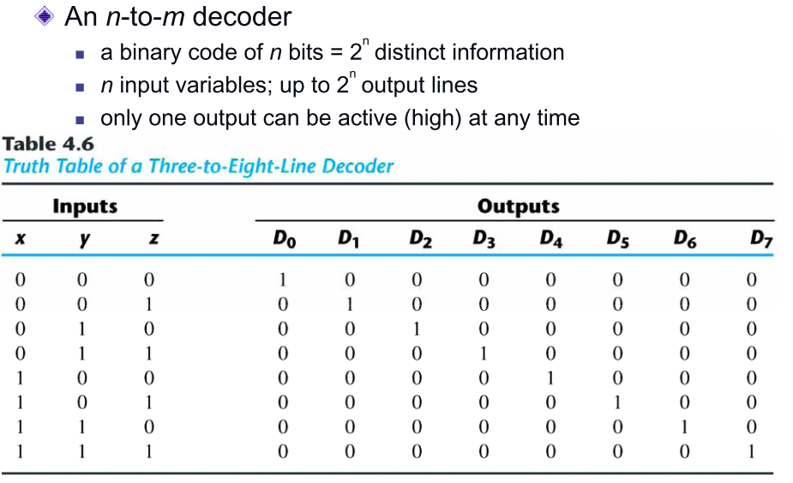
Decoder

Slide 33
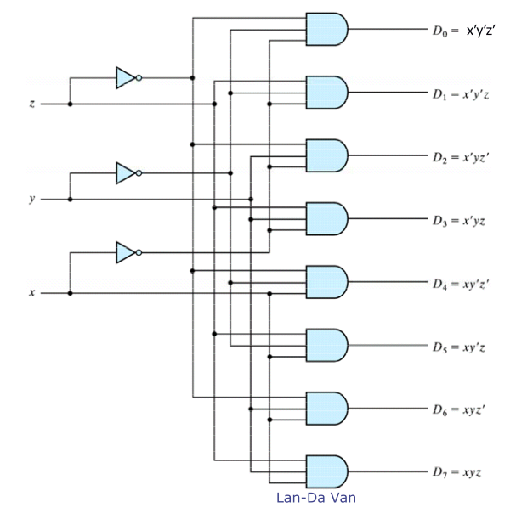
Three-to-Eight Line Decoder

Slide 34
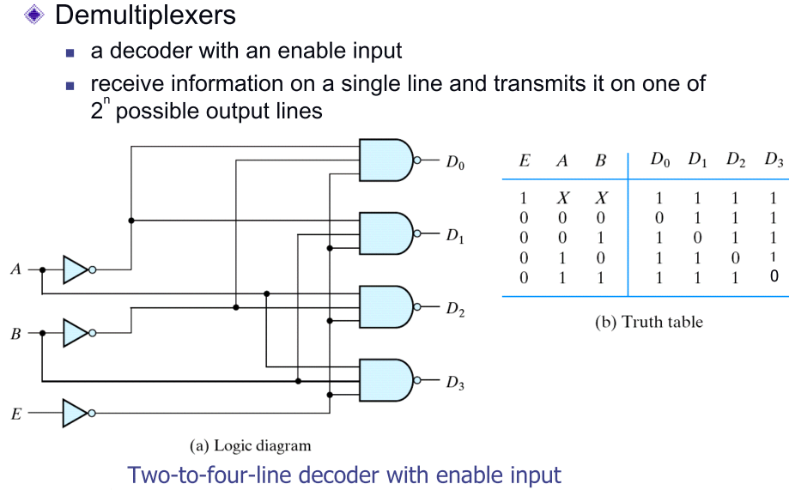
Demultiplexer

Slide 35
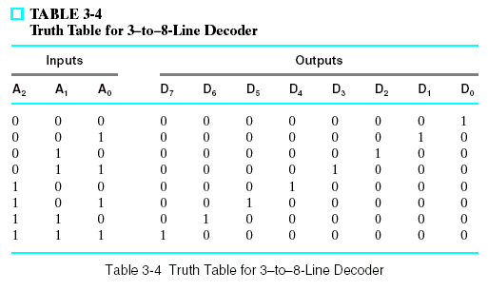
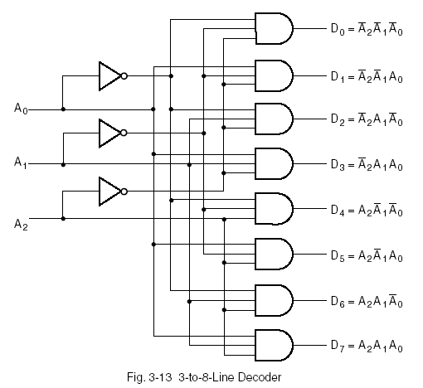
Decoder Examples
3-to-8-Line Decoder: example: Binary-to-octal conversion.
D₀ = m0 = A₂’A₁’A₀’
D1= m1 = A₂’A₁’A₀
_{…etc}

Slide 36

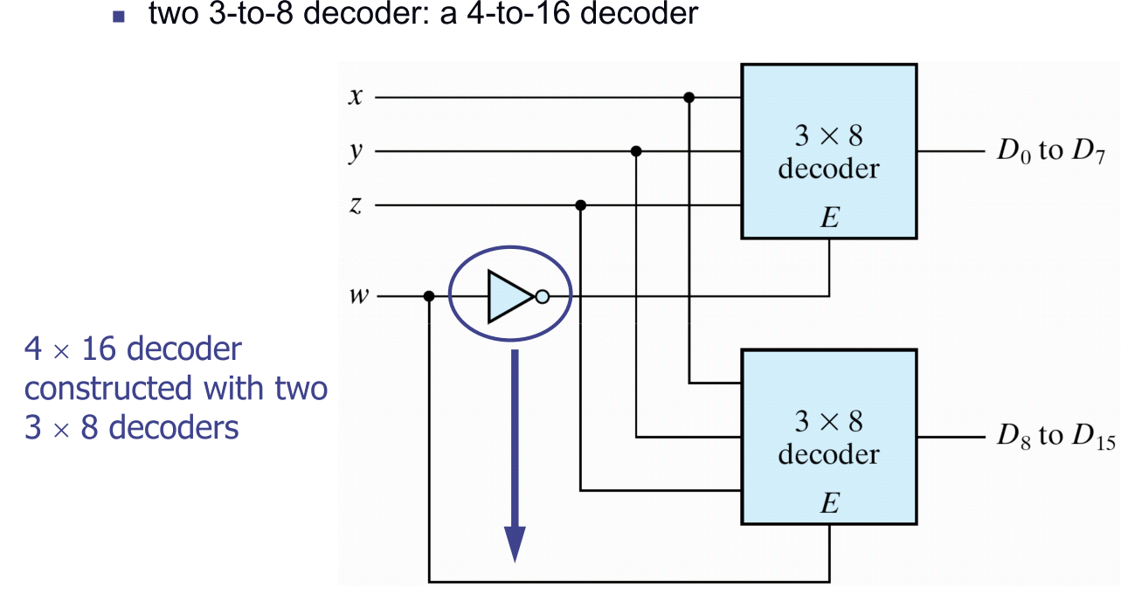

Slide 37
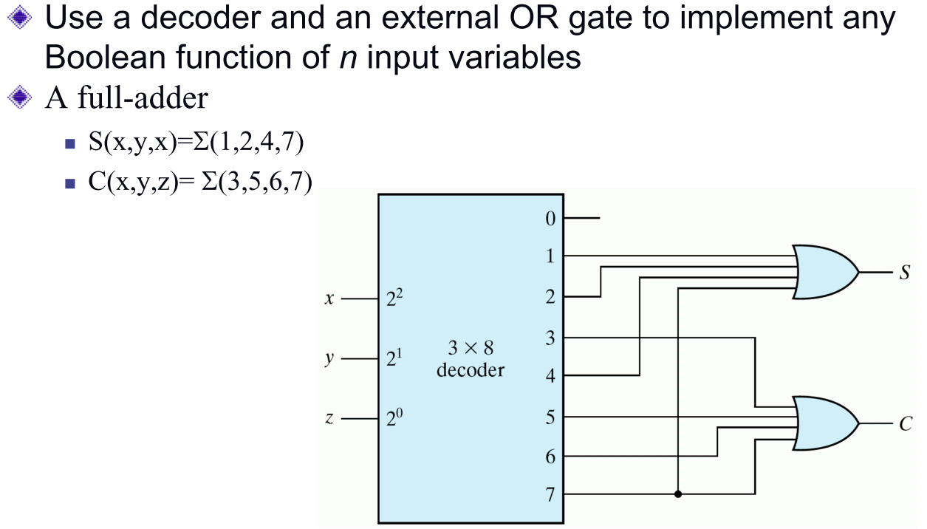
Implementation

Slide 38
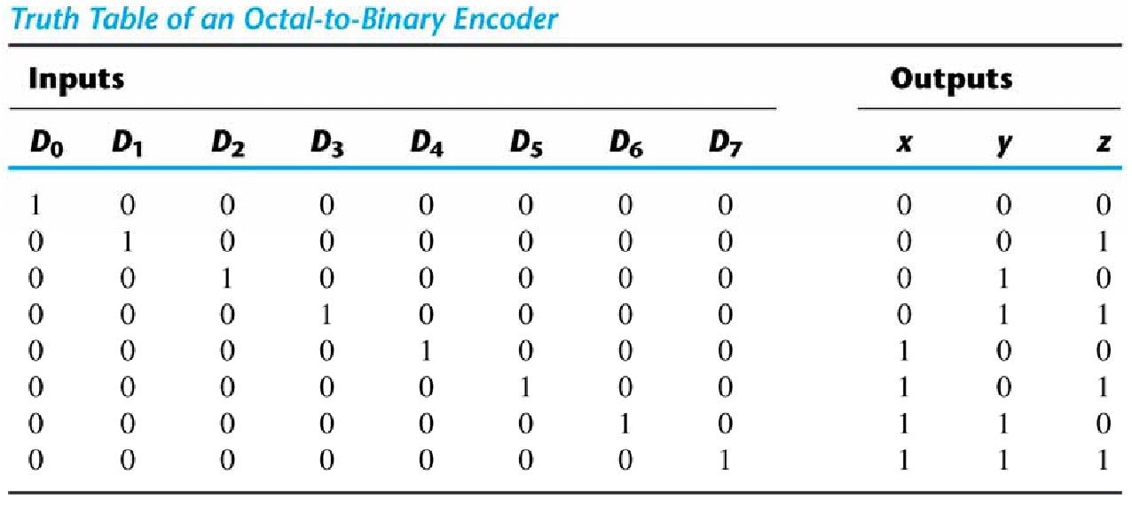
Encoder
z
=
D
+
D
+
D
+
D
1 3 5 7
y
=
D
+
D
+
D
+
D
The encoder can be implemented
2 3 6 7
with three OR gates.
x
=
D
+
D
+
D
+
D
4 5 6 7

Slide 39
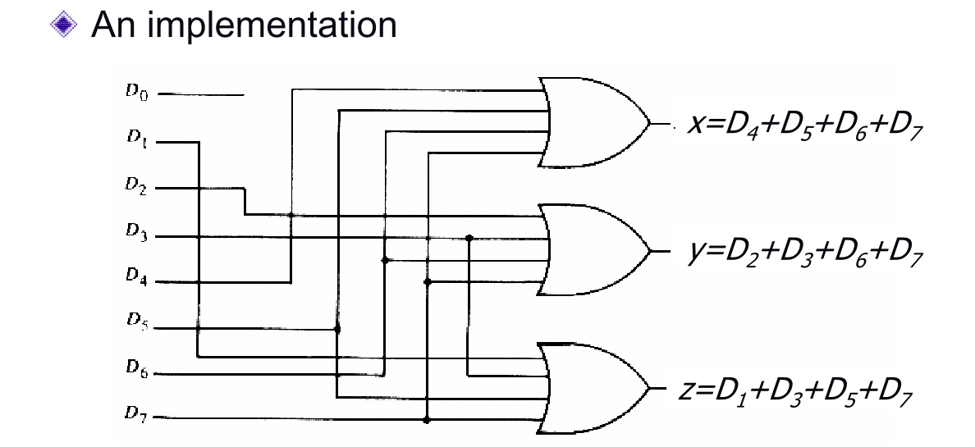
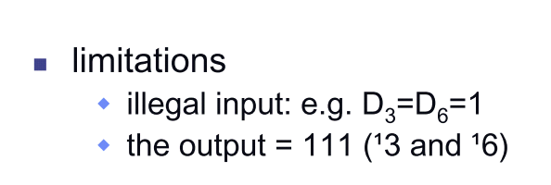
Encoder

Slide 40
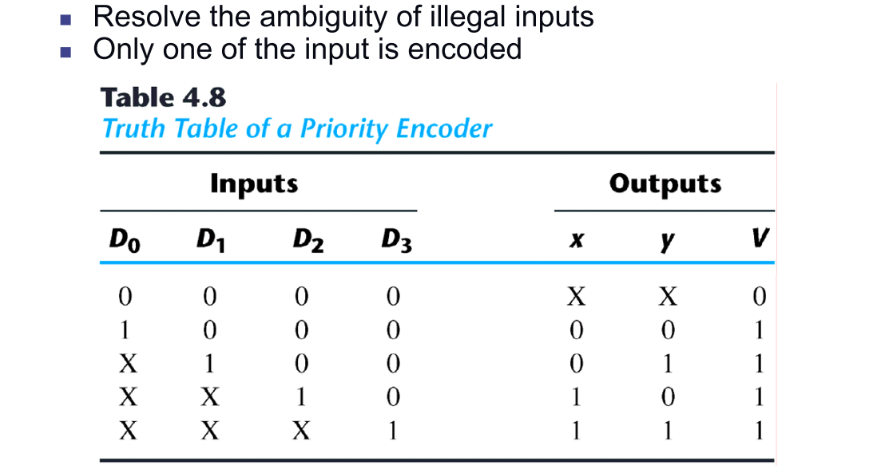
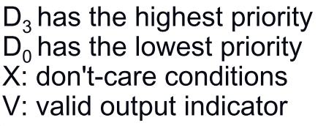
Priority Encoder

Slide 41
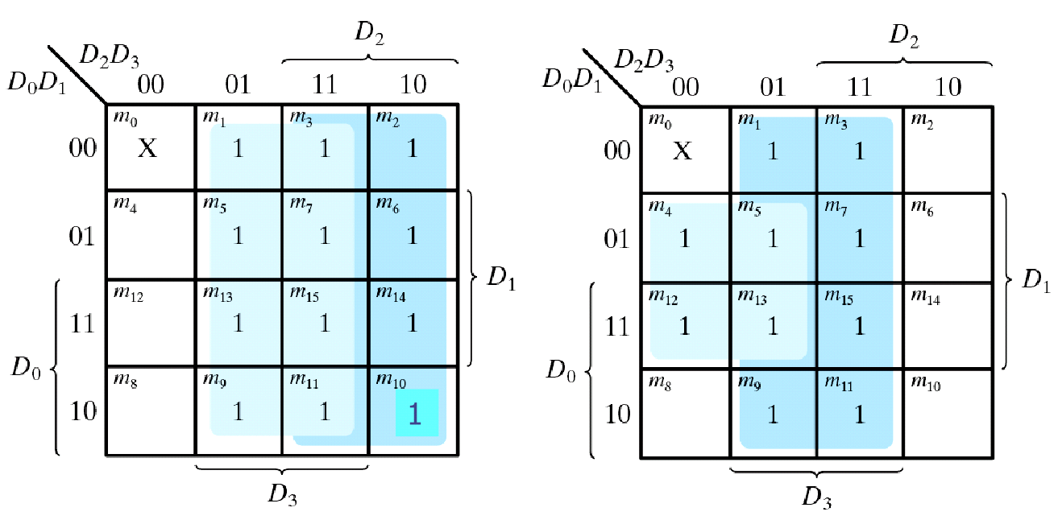
Priority Encoder

Slide 42
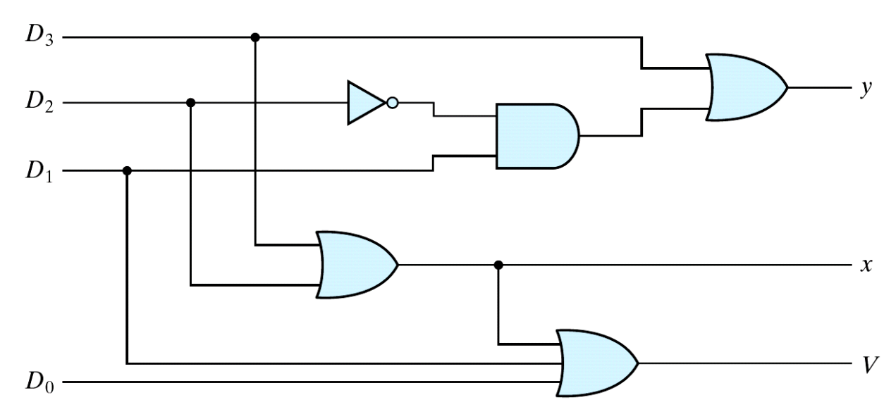
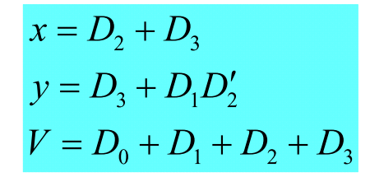
Priority Encoder

Slide 43
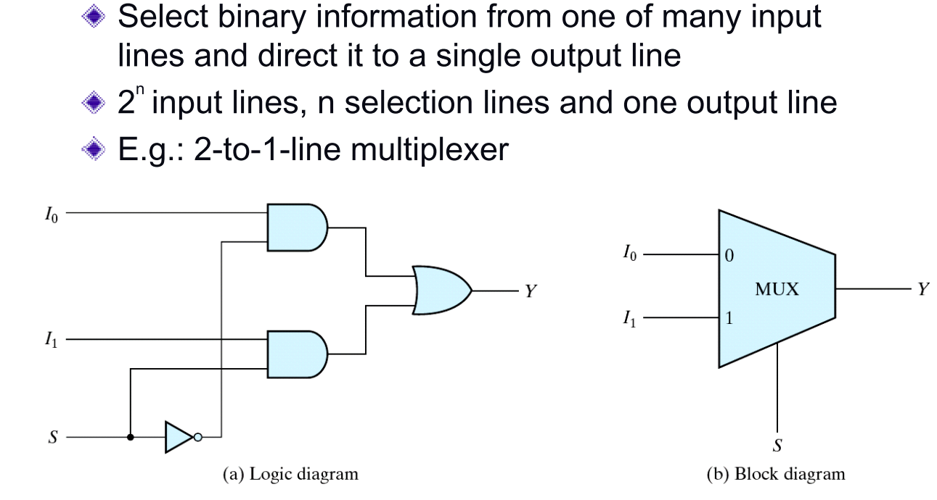
4-11 Multiplexers

Slide 44
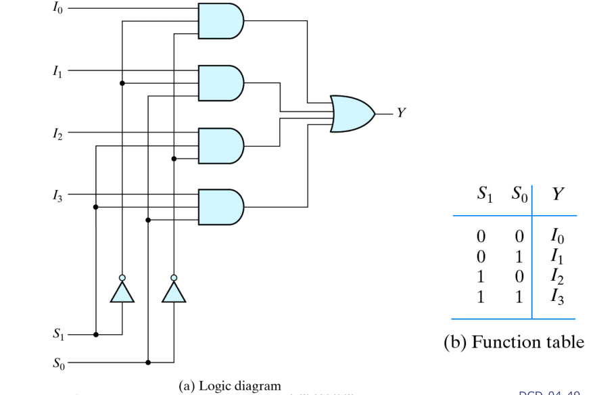
4-to-1-line multiplexer

Slide 45
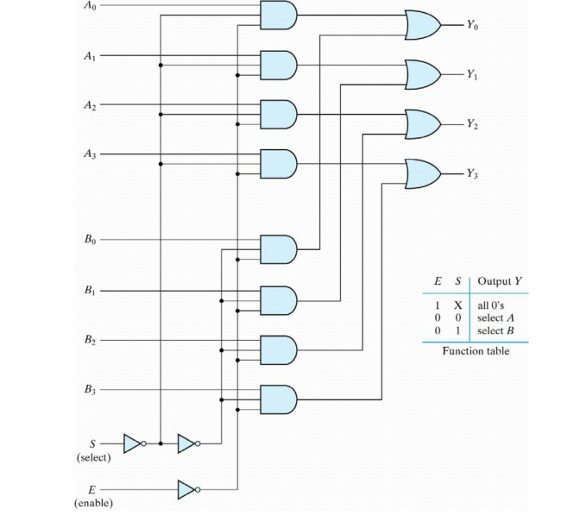
Quadruple two-to-one-line multiplexer

Slide 46
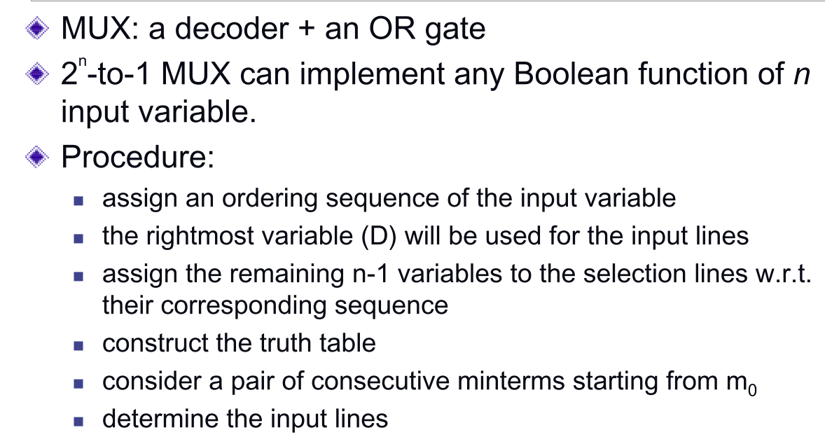
Boolean function implementation

Slide 47
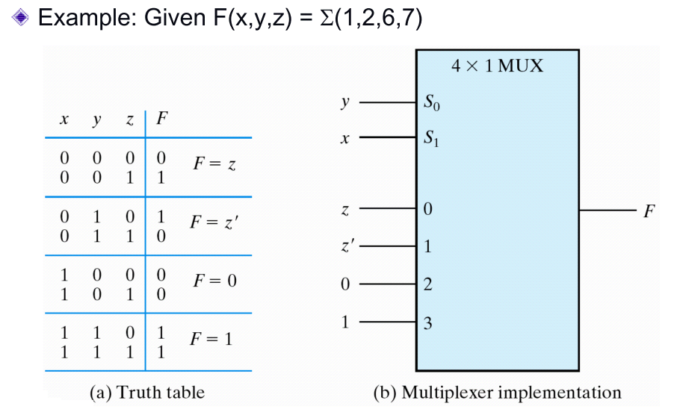

Slide 48
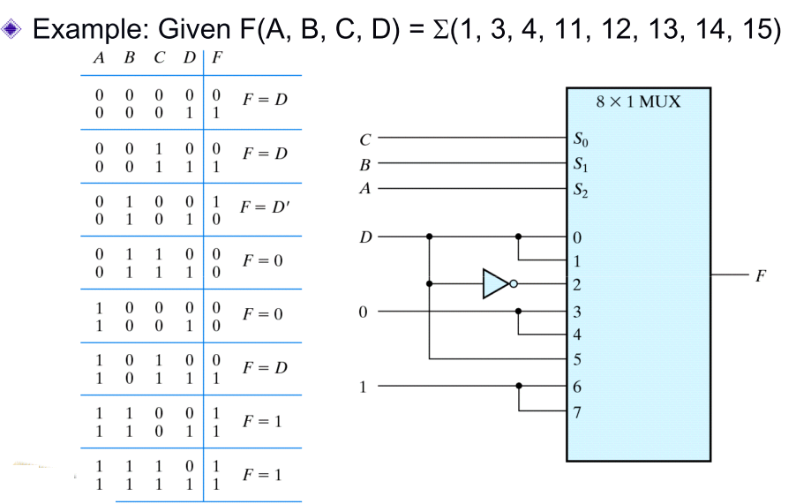

Slide 49

Three-State Gate

Slide 50

Four-to-One-Line Multiplexer

